Slide 1
CEEC Workshop: Maximizing CFD Code Efficiency: A workshop on Continuous Integration, Benchmarking, and Testing in Cluster Environments
Notes:
write name, i hope to help you learn.....

Slide 2
What is Cx ?
Continuous Integration (CI) | is the practice of automatically integrating code changes into a software project. It relies on a code repository that supports automated building and testing. Often, CI also involves setting up a build system from scratch, including all dependencies.
Continuous Testing (CT) | is the practice of executing automated tests as an integral part of the software development process. It tries to make sure that no functionality is lost and no errors are introduced during development.
Continuous Benchmarking (CB) | can be seen as a variant of CT, where not only functionality but also performance is tested in order to avoid regressions, i.e., unwanted performance degradation due to code changes.
Continuous Deploying (CD) | is the automatic deployment of the software coming out of the other Cx processes. This can be the installation on a particular system, rolling out a revision within a whole organization, pushing installation packages to public repositories, etc.
Notes:
Today we have participants with different level of experience. Some of you have more familiarity with CI/CD and some of you are new to this topic. Therefore we would like to bring everyone to the same level so that they can follow along with the workshop. Let us begin with the basics , by answering the question what is Cx ? Please bear with for a couple of minutes.
Ci: is an automated process in software development where different code developers integrate their code to one central/shared repository. This central repository support auomtated building and testing of the software and make sure that code changes are integrated in the main repo frequently without any integration errors. CI often involves setting up the build system from scratch, including all the depndency

Slide 3
What are Gitlab runners?
GitLab Runner is an application that works together with GitLab CI/CD to execute jobs in a pipeline.
Runners picks up the task such as building, testing, deploying and pass them to the executors, which run the jobs.
Gitlab Runners
Runners
Executors
Talks to API and executors
Do the CI/CD jobs

Slide 4
Gitlab CI/CD configuration file (.gitlab-ci.yml)
It is the central management file for CI
Must be in the Root of the repository
What it can do?
  Define and run scripts
  Include other compatible files (jobs) such as YAML file
  Control serial or parallel execution of jobs
Stage build
Stage test
Pipeline 1
Job 1.1
Job 1.2
Job 1.3
Pipeline 2
Job 2.1
Job 2.2
Job 2.3

Slide 5




Gitlab CI/CD configuration file
Pipelines: Top level components of CI/CD
Pipelines comprises of :
  Stages: different phases of CI/CD, When to run the jobs ? Stages that run thes test after Stages that compile the test
  Jobs: what to do ? Compile ? Run ?
Jobs are executed by runners. Multiple jobs in the same stage are executed in parallel, if there are enough concurrent runners.
If all jobs succeed
Pipeline moves to next stage
Stage 2
For e.g. Test
Stage 1
For e.g. Build
If any jobs fails
Next stage is (usually) not executed
Stage 1
For e.g. Build
Stage 2
For e.g. Test
Pipeline ends early

Slide 6
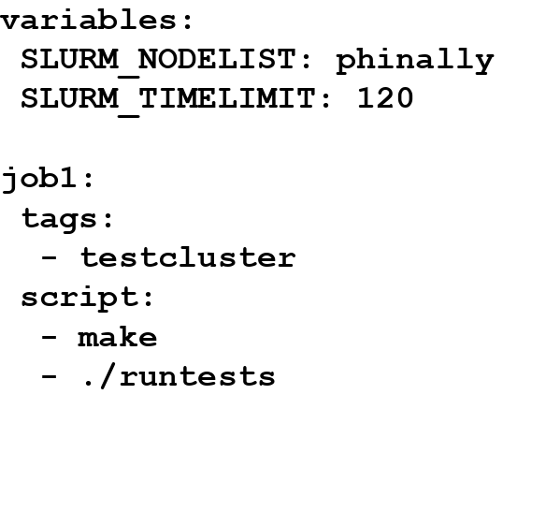
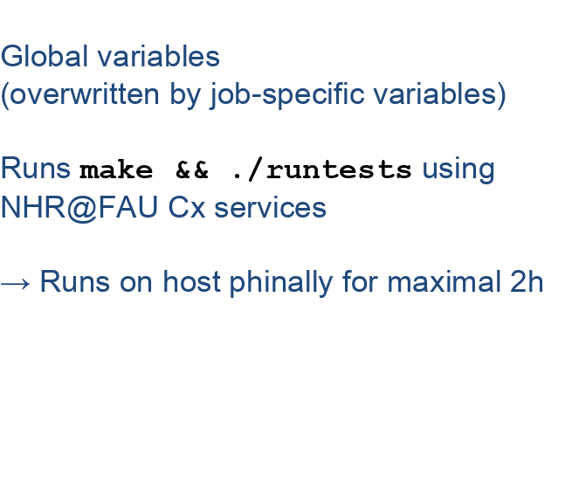
An example to gitlab-ci.yml file
For beginners: Use Gitlab CI editor, it does syntax checks
Notes:
blurry slide, adjust allignments

Slide 7
Building different Stages
.pre
Build
Test
Deploy
.post
CI Pipelines consist of multiple stages
Stages and their order can be self defined with stages keyword
Basic stages:
  .pre : Do basic checks like input file formats (can be given any other name or functionality to perform)
  build : Setup build system, build application, store as artifact
  test : Get artifact, setup runtime(!) system, run application tests
  deploy : here, we are deploying to web page (push to package indices like PyPI)
Notes:
mention what .post

Slide 8





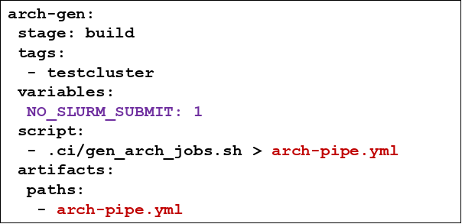
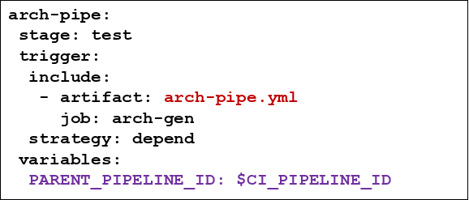
Do I need a job for each X (X={system, cuda, intel64}) ?
Tedious to write a job for each X and keep it up-to-date
How to dynamically create jobs ?
.gitlab-ci.yml
Main Pipeline
Notes:
change yellow box

Slide 9
Christoph’s Session

Slide 10
Hands-On Session

Slide 11
Accessing the repository
Each participant gets an index such as :
Participant_00 - https://gitos.rrze.fau.de/cx_workshop_01_ceec/participant_00
Please clone or work on your respective repository
Who does not have account on gitos.rrze.fau.de:
To push the repository:
git remote set-url --push origin "https://token_name:generated_token@gitos.rrze.fau.de/cx_workshop_01_ceec/repository_name.git"
Example: git remote set-url --push origin "https://public_test:FrsS7yH4Ra2VHELsMCP@gitos.rrze.fau.de/cx_workshop_01_ceec/participant_00.git"
Please keep the token safe until the end of the workshop !
Notes:
by then send the token to the participants

Slide 12
accessing repository
https://gitos.rrze.fau.de/cx_workshop_01_ceec/participant_01
git clone
cd participant_01
git remote add <your_repository_name> <your_repository_url>
Participant who do not have accounts on gitos.rrze.fau.de can use: git push https://token_name:<project_access_token>@gitos.rrze.fau.de/<cx_workshop_01_ceec/repository_name>.git to push the repository otherwise use: git push <your_repository>

Slide 13
Connecting to RRZE
Project must be hosted on one of the two RRZE Gitlab instances
gitlab.rrze with Enterprise features for FAU-internal projects
gitos.rrze for projects in the German/European research community
(attached to DFN-AAI)
A valid HPC user account at HPC4FAU and/or NHR@FAU
Create an SSH-key (no passphrase)
$ ssh-keygen -t ed25519 -f id_ssh_ed25519_gitlab
$ ls
Id_ssh_ed25519_gitlab id_ssh_ed25519_gitlab.pub
Private key
Public key
This is already done for your repository!

Slide 14
Connecting to RRZE
Users must have access to HPC, access to gitlab.rrze.fau.de (external users can use gitos.rrze.fau.de), generate ssh-key pair
Send email to hpc-support@fau.de with
  Repository URL
  HPC account name
  Public SSH key (should be a key used only for Cx)
In the repository (Settings → CI/CD)
Runners: Activate shared HPC runner
Variables:
Create AUTH_USER with HPC account name
Create AUTH_KEY with private SSH key (copy & paste)
Create .gitlab-ci.yml from scratch or use the CI editor
This is already done for your repository!

Slide 15
Lets write first gitlab-ci.yml file :)
Code base: 2D 5-point Stencil Jacobi Solver
Copy the example code from https://gitos.rrze.fau.de/cx_workshop_01_ceec/participant_01
Here is an example of build stage
Similarly write your own test stage to run the application
Artifacts: Pass the build folder to test stage
Tips:
  Mention SLURM_NODELIST in the test stage (hasep1, broadep2, ivyep1, naples1)
  Command line arguments: iterations, rows, cols
  For example- SLURM_NODELIST: “hasep1”
Commit your changes
Check the results
If you are stuck please have a look at the solution in https://gitos.rrze.fau.de/cx_workshop_01_ceec/team_00
Notes:
Task 1

Slide 16
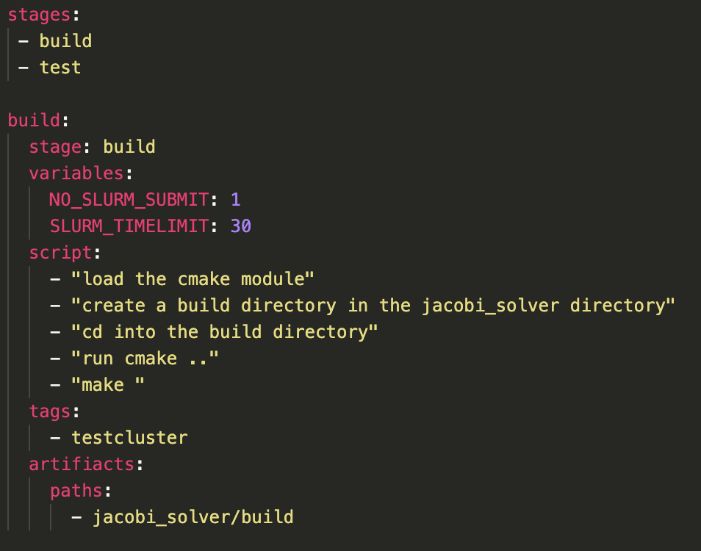
Lets write first gitlab-ci.yml file :)
Code base: 2D 5-point Stencil Jacobi Solver
Copy the example code from
Here is an example of build stage
Similarly write your own test stage to run the application
Artifacts: Pass the build folder to test stage
Tips:
  Mention SLURM_NODELIST in the test stage (hasep1, broadep2, ivyep1, naples1)
  Command line arguments: iterations, rows, cols
  For example- SLURM_NODELIST: “hasep1”
Commit your changes
Check the results
If you are stuck please have a look at the solution in
Notes:
Task 1

Slide 17
Break
until 10:45

Slide 18
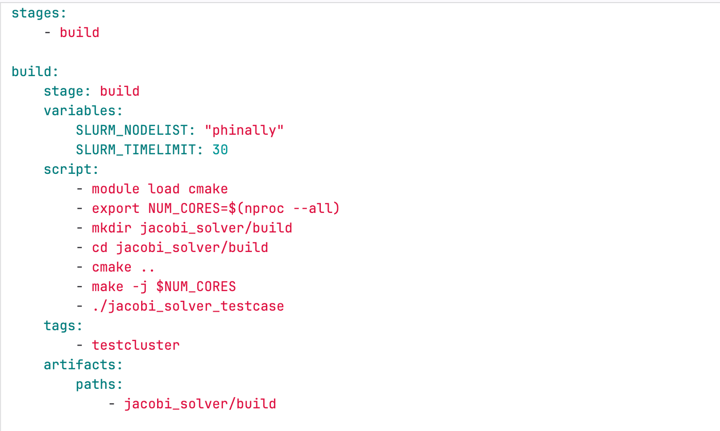
My first gitlab-ci.yml

Slide 19
Visualisation
Two types of visualisation:
  Using python plotting script:
    Generate plot in pipeline with plotly
    Use GitLab pages for hosting
    Use artifacts from the last pipeline execution
  Using Grafana:
    Store data in InfluxDB
    Create Dashboard in Grafana
Grafana is an open source analytics and visualisation platform
The plots can be uploaded to Grafana using python library InfluxDB.

Slide 20
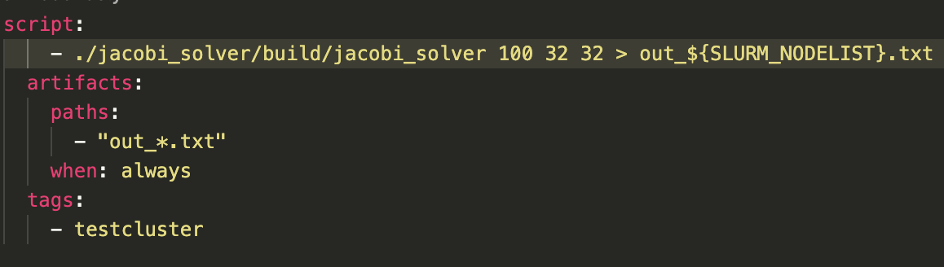
Visualisation
For visualisation:
  process_results.py
  plot.py
Modify test stage
out_${SLURM_NODELIST}.txt saves the result such as execution time, performance, etc.
Pass out_*.txt file as artifacts, which will be used later
Load required modules
Notes:
Task 2

Slide 21
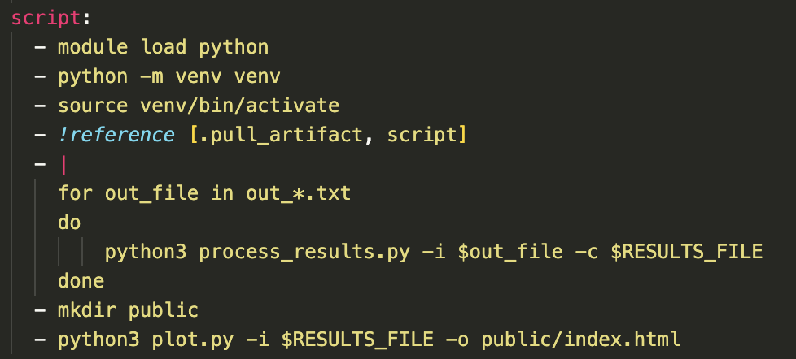
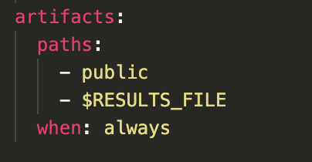
Visualization
Add deploy stage and name the job as “pages”
You can check solution for reference here:
Download artifacts
Notes:
Task 3. (following task2 so solutions are compiled together)
What is artifact ?

Slide 22
see you at 12:45

Slide 23
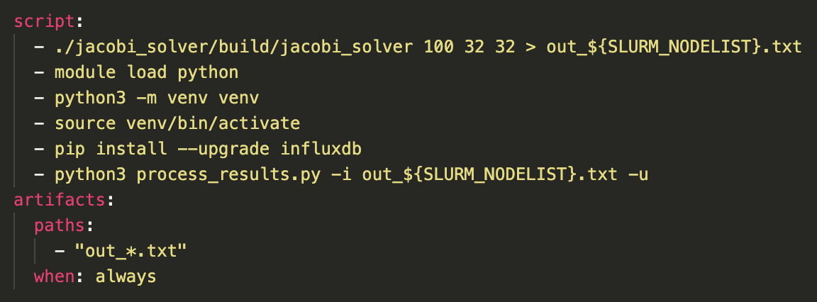
Visualization using Grafana
Modify the test stage
Install influxdb: a database used to upload the results in Grafana
Either use -u to upload the results or use results.csv file to save the results
Similarly, add it to the pages
Notes:
Task 4

Slide 24
Visualizing in Grafana
Use process_results.py to upload data to InfluxDB
Grafana Instance: https://www10.cs.fau.de/grafana/
Use the Folder ‘CXWorkshop’
Create your own dashboard
The measurment name is your repository name: Participant_{ID}

Slide 25
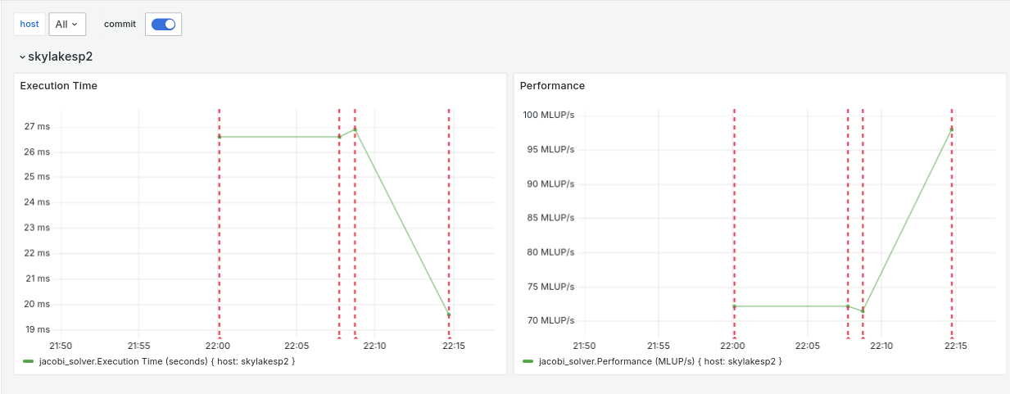
Visualizing in Grafana - Example

Slide 26
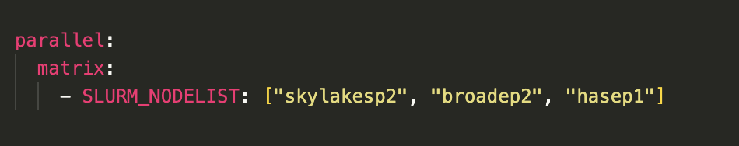
Working on different architectures
Add different architecture in the test stage and visualise the performance
Notes:
Task 5

Slide 27
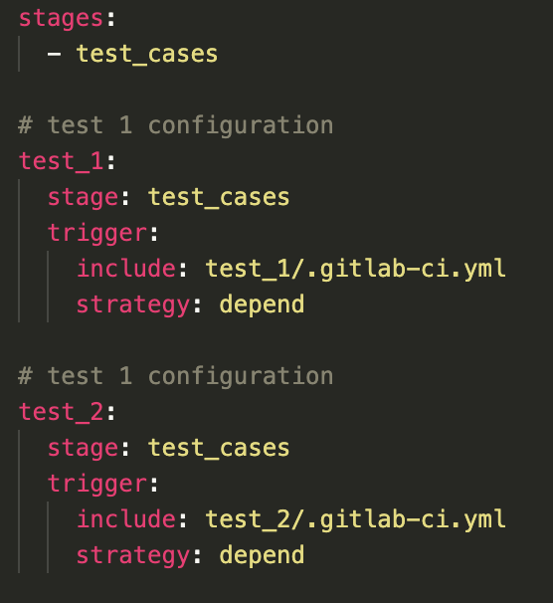
Parent-child pipeline
You can create parent/child pipeline using different YAML files
Instead of having a big configuration file, create multiple small files and one managing the small files
Parent configuration file remains in the root and manages other child pipelines
‘trigger’ : the keyword to create child pipeline
‘include’: include the configuration file of the child pipeline
‘strategy’: if strategy is set (depend), parent pipeline success depends on child pipeline
Notes:
If they want to try

Slide 28
Open-ended session - depends on the time
Play with your code using openmp
Play with walberla benchmark case and visualise using grafana
Try running your own code on cluster
Please fill the feedback form :)

Slide 31
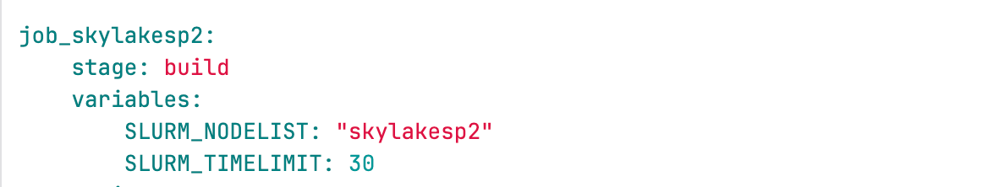
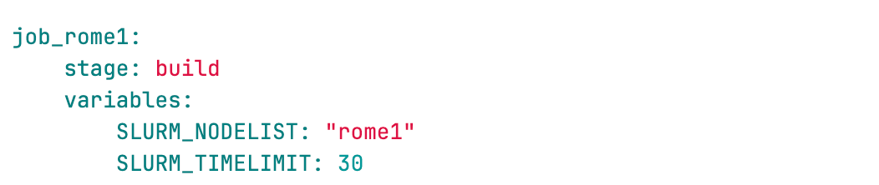
Building different jobs
To not mess the test cases, create a new branch from the main branch (commit your main branch before that if you have not)
Name it username/learning_ci or any other name
Open the gitlab-ci.yml file
Running different pipelines on different hosts

Slide 32
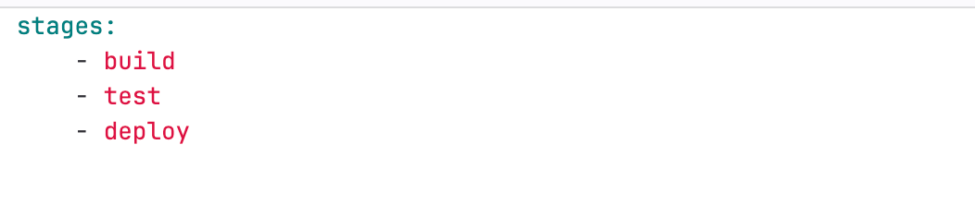

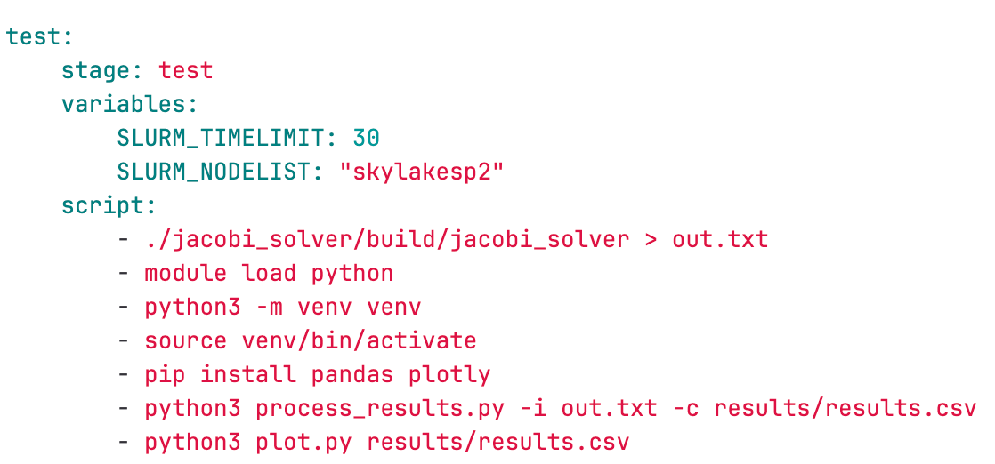
Building stages and visualisation

Slide 33
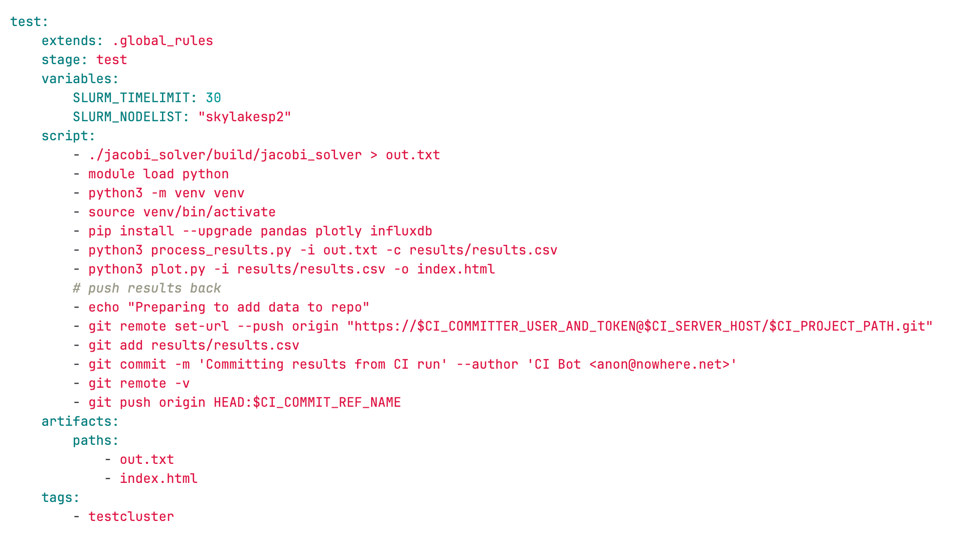

Building stages and visalisation

Slide 34
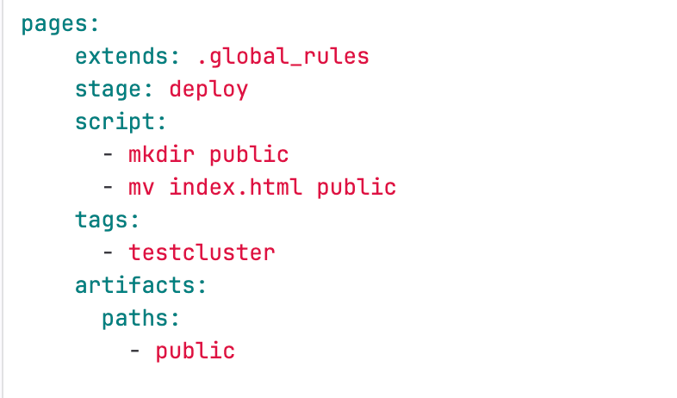
Building stages and visalisation

Slide 35
Optimisation of Jacobi or try WaLBerla
Optimize the code using OpenMp
Write #pragma openmp barrier before the loop second loop
Changes to be made in the gitlab-ci.yml ?

